Slide 1
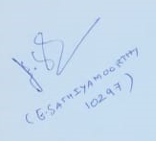
WORDZONE
Capstone Project
GUIDE –
E SATHIYAMOORTHY
Presenter –
Ritveak dugar – 16bit0407

Slide 2
What is WordZone?
It is a place where user can execute multiple word related queries and by using the data generated by the user, Wordzone suggests new words to the user to learn.
It is a place where one can Find, understand, know and Learn words.
And hence it is a playground where users can explore and improve their vocabulary

Slide 3
What does it have?
It has Four parts:
Find Zone - Where user can find words for crossword, scrabble and rhymes.
Understand Zone – Where user can understand their word.
Knowledge Zone – Where user can know more words related to the entered word, like synonyms, antonyms etc.
Learning Zone – Where user can learn new words on the basis of their vocabulary

Slide 4
Tech Stack
PROGRAMMING LANGUAGE :
PYTHON
KIVY
TOOLS AND LIBRARIES:
NLTK
SPELL CHECKER
PRONOUNCING
DATAMUSE AND OXFORD API
WORDFREQ
PICKLE
TRAINING MODEL
LSTM

Slide 5
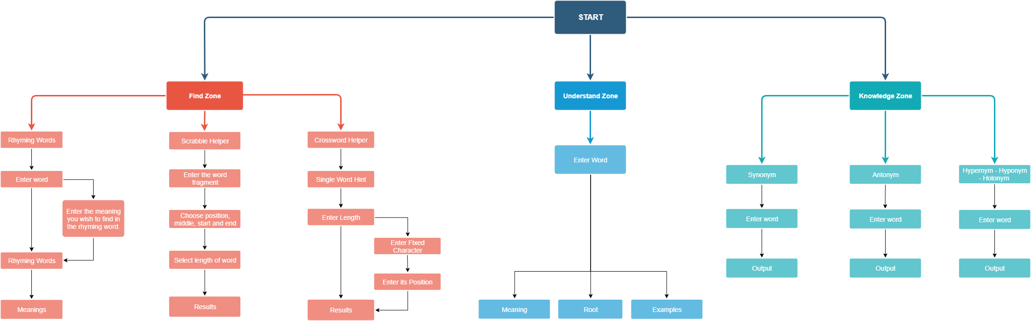
Modules and Detailed workflow

Slide 6
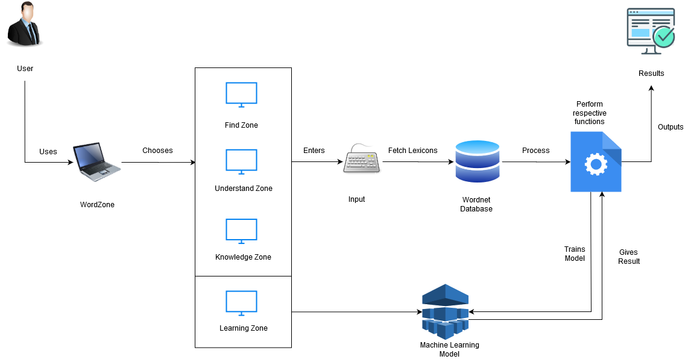
System Architecture:

Slide 7
FINDZONE
Rhymer Dictionary – Helps in finding rhyming words with particular meaning.
Crossword Helper – Find words for your crossword either a single word or intersecting words.
Scrabble helper – Find words with entered word fragments and defined length and position.

Slide 8
UNDERSTAND ZONE
Understand word that is being entered by seeing the different definitions and their respective meanings.

Slide 9
KNOWLEDGE ZONE
Similar meaning Words
Opposite meaning words
Hypernymns- Words which targets a Superset of entered word eg – Color is a hypernym of Red.
Hyponymn – Words which target a subset of entered word. Eg – Crimson Red is Hyponymn of red.
Holonym – Words that are broader part of the entered word. Eg body is holonym of arm.

Slide 10
LEARNING ZONE
Low level words – Shows words which are very near to user’s vocabulary, to learn.
Medium Level Words – Shows words which are just above user’s vocabulary, to learn.
High Level Words – Shows really tough words based on the results generated by wordzone, to learn.

Slide 11
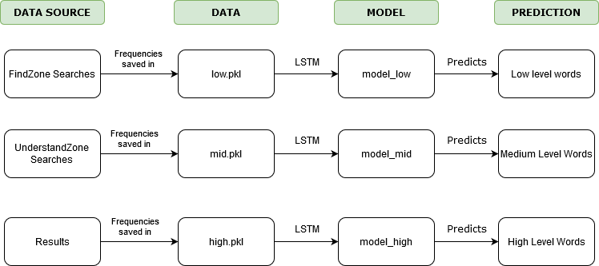
Data Training

Slide 12
Why LSTM
Univariate Time Series Data.
RNN (which is usually the choice for sequential data) had vanishing linear gradient problem and has no control over which part of old data needs to be forgotten.
LSTM uses gated network which helps it avoid both the problems.

Slide 13

Demo Walkthrough of WordZone

Slide 14
RMS Error
Model | RMS Error
Low | 0.5369047
Mid | 0.6762149
High | 1.3645634

Slide 15
Future Work
More details can be shown in the results of each section, like their part of speech and varied usage.
WordZone should be modified in such a way that it auto trains after entry of substantial amount of new data.
Research on whether old data should be deleted or kept for predicting words as per user’s current vocabulary.
Research on finding better feature than frequency of a word in English Language for getting toughness of a word from vocabulary point of view.
Since Kivy can be used for Mobile App development also, making an spp and publishing it is also a viable future work.

Slide 16
THANK YOU

